Slide 1
Linear Regression

Slide 2
What is Regression?
Regression means predicting target numeric value
Sales = W₁*TV_budget + W₂*Newspaper_budget+W₃*Radio_budget
Process of finding those W₁, W₂ and W₃ is called as regression
Regression was invented by the cousin of Charles Darwin, Francis Galton. Galton did his first regression in 1877 to estimate the size of pea(matar) seeds based on the size of their parents’ seeds.

Slide 3
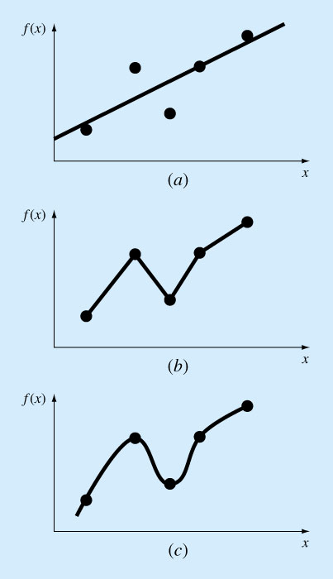
Curve Fitting
There are two general approaches two curve fitting:
Regression
Data exhibit a significant degree of scatter. The strategy is to derive a single curve that represents the general trend of the data.
Interpolation
Data is very precise. The strategy is to pass a curve or a series of curves through each of the points

Slide 4
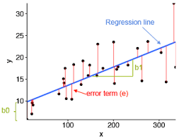
Least Squares Regression
Fitting a straight line to a set of paired observations: (x1, y1), (x2, y2),…,(xn, yn).
y=a₀+a₁x+e
a₁- slope
a₀- intercept
e- error, or residual, between the
model and the observations.

Slide 5
Least Squares Regression
Fitting a straight line to a set of paired observations: (x1, y1), (x2, y2),…,(xn, yn).
y=a₀+a₁x+e
a₁- slope
a₀- intercept
e- error, or residual, between the
model and the observations.
e_{i}=y_{i,observed} − y_{i,fitted} = y_{i}−(a₀+a₁x_{i})

Slide 6

Least Squares Regression
e_{i}=y_{i,observed} − y_{i,fitted} = y_{i}−(a₀+a₁x_{i})
Criterion(loss/cost) for a best fit:

Slide 7
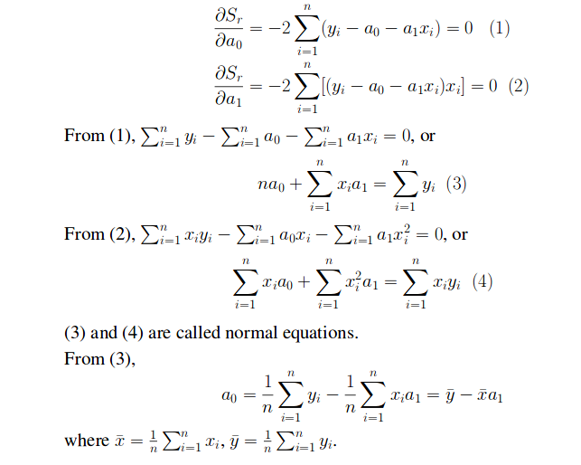
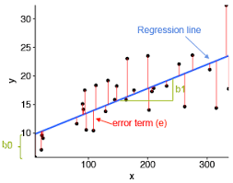
How can we go from a bunch of data to our regression equation?

Slide 8
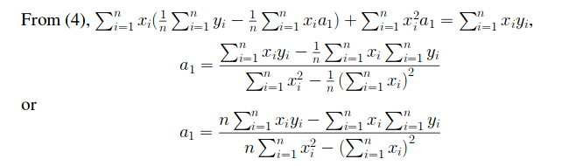
How can we go from a bunch of data to our regression equation?

Slide 9
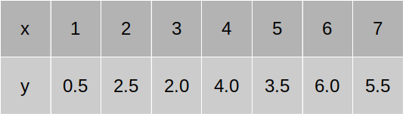
Numerical
Find the parameters of the line that fit the best to this data.

Slide 10
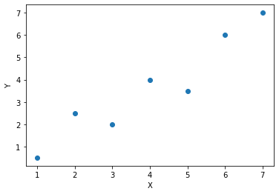
Numerical
Find the parameters of the line that fit the best to this data.
m=?
c=?

Slide 11
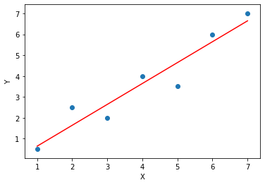
Numerical
m=1
c=-0.35

Slide 12
Normal Equation
(X^{T}X)⁻¹X^{T}y

Slide 13
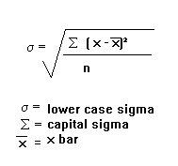
Standard deviation
Calculate standard deviation of y?

Slide 14

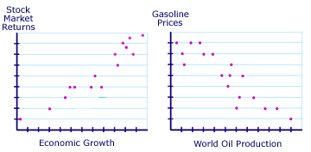
Covariance
Variables are positively related if they move in the same direction.
Variables are inversely related if they move in opposite directions.

Slide 15

Correlation
Correlation is degree to the degree which a pair of variables linearly related
Correlation is +1 if variables are perfectly directly increasing linear relationship
Correlation is -1 if variables are perfectly directly decreasing linear relationship
If two variables are independent then correlation is zero(it’s fuzzy )
Calculate correlation of y_{true},Y_{predict}

Slide 16

R squared (Coefficient of determination)
How much prediction error is eliminated when we do regression.
R² is always between [0,1]
If R² is towards 1 means regression line is pretty accurate
If it is towards zero means might be our model is not good fit.
Why R² is square of correlation?

